Slide 1
Team 1
By Darryl, Po Jid, Yong Xian
2019, May 25

Slide 2
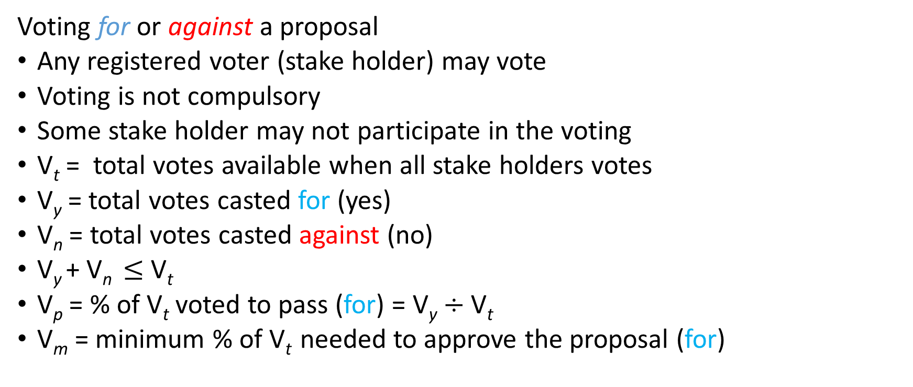
Voting System
Voting for or against a proposal
Any registered voter (stake holder) may vote
Voting is not compulsory
Some stake holder may not participate in the voting
V_{t} = total votes available when all stake holders votes
V_{y} = total votes casted for (yes)
V_{n} = total votes casted against (no)
V_{y} + V_{n} $≤$V_{t}
V_{p} = % of V_{t} voted to pass (for) = V_{y} $÷$ V_{t}
V_{m} = minimum % of V_{t} needed to approve the proposal (for)

Slide 3
Voting System
Voting states
Voting has states V_{s} :[WAIT, READY, COMPLETED, ABORTED]
WAIT : New voting being setup, not accepting votes yet
READY : Invitation to vote, voting in progress
COMPLETED : Voting completed, we have a resolution V_{R}
ABORTED : Voting cancelled
for example nobody voted upon voting expiry,
or voting called off

Slide 4

Voting System
Outcome of voting : Resolution
Resolution V_{R} :[PASSED, DEFEATED]
PASSED : V_{p} $≥$ V_{m}
DEFEATED : V_{p} $<$ V_{m}
Resolution is automatic

Slide 5
Voting System
Votes must be collected within agreed period : T_{v}
Elapse time T_{e} starts when V_{s} = READY
When T_{e} > T_{v}
V_{s} = COMPLETED, We compute resolution V_{R}

Slide 6
Voting System
Possible public functions to be provided
Functions | State V_{s} | Inputs | Outputs | Admin functions
VS_RegisterMe() | WAIT | Id/address | add to voters[]
VS_CastMyVote() | READY | Id/address, yes-no | add to votes[], V_{R}
VS_GetResolution() | COMPLETED | Id/address | V_{R}
VS_New() | WAIT | Id, P, V_{m}, T_{v} | SetProposal(P, V_{m}, T_{v}) | X
VS_Abort() | ABORTED | Id | V_{s} = ABORTED | X
VS_DropVoter() | WAIT | Id, Id/address | voters.remove() | X
VS_GetProposalDetails() | any | Id | proposal details | X
VS_Extend() | READY | Id, t | T_{v} = T_{v} + t | X
……

